Slide 1
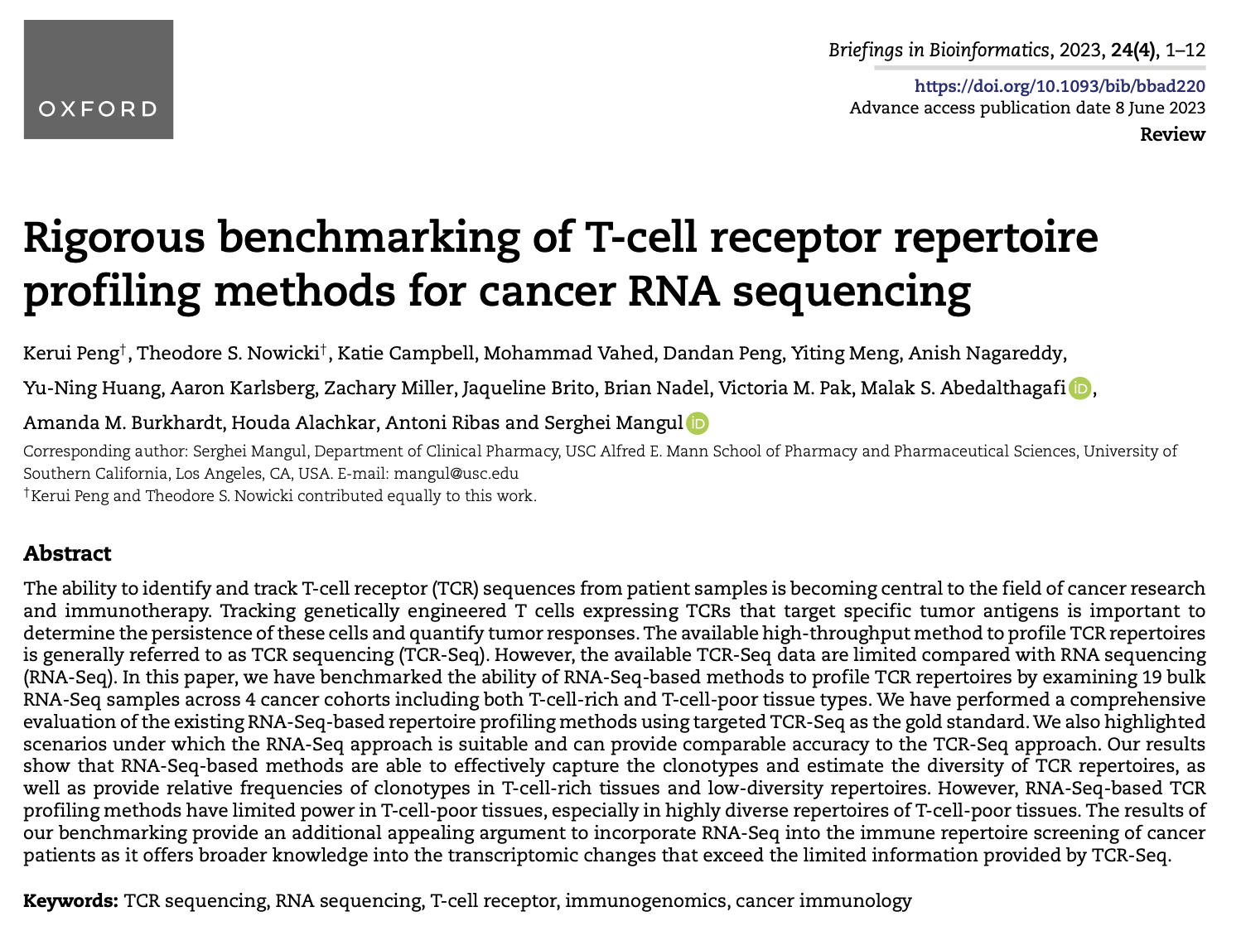
Journal club
1-9-2024
Ty Bottorff

Slide 2
Background
Available TCR-seq data is limited compared with RNA-seq data
MiXCR (RNA-seq method) has detected TCR beta sequences with relative frequencies > 0.15% in T cell rich tissue (PMC6169298)

Slide 3
Goal
Use RNA-seq-based methods (in lieu of TCR-seq-based ones) to profile TCR repertoires
for example in immune repertoire screenings of cancer patients
measuring diversity, clonality, tracking engineered T cells expressing chimeric TCRs targeting tumor antigens…
RNA-Seq-based TCR profiling methods have not been benchmarked, only validated in small numbers of samples

Slide 4
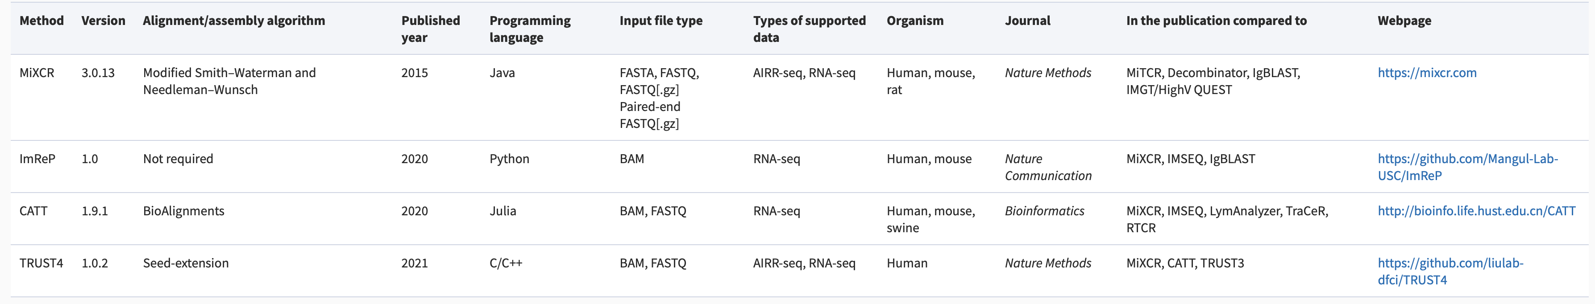
RNAseq methods
Compare RNA-seq-based methods to targeted TCR-seq (gold standard, beta chain)
Assembly algorithm differs by method
Notes:
at bulk level, assembly may get confused with very similar TCRs from different cells, wouldn't have issue at single cell level. but I think JC paper is bulk, perhaps this is related to why they cant detect rare ones (assembly fails)
We excluded IMSEQ [21] because it was originally designed for TCR or immunoglobulin (Ig) sequencing, but not for RNA-Seq

Slide 5
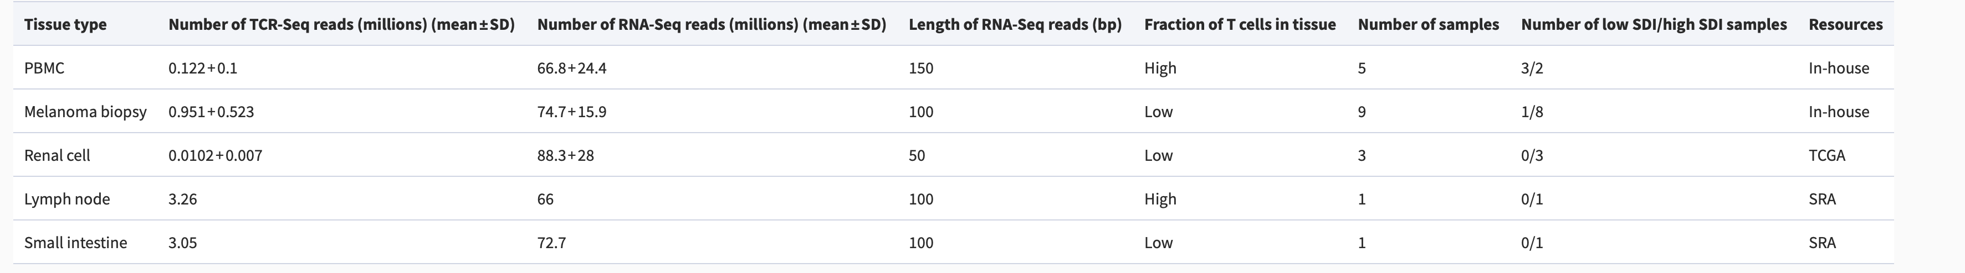
Samples
Examine 19 bulk RNA-seq samples across 4 cancer cohorts in both T-cell-rich and T-cell-poor tissues
Lymph node and small intestine samples sequenced by 5’ RACE
Other samples sequenced by ImmunoSEQ (Adaptive)
Notes:
melanoma specimens from the ileocecal lymph node

Slide 6
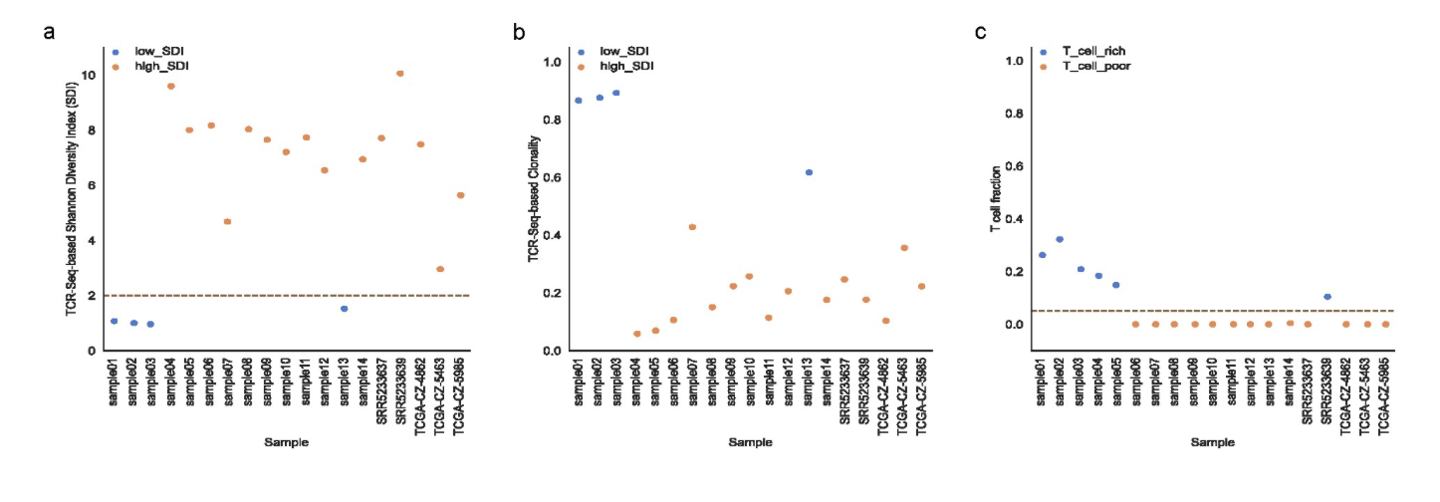
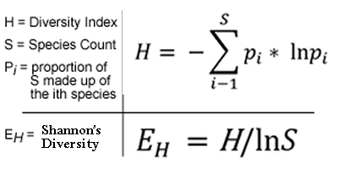
Distribution of SDIs, clonality scores, T cell fractions across samples
SDI of 2 is cutoff between
low and high groups
Notes:
Define samples with Shannon diversity index (SDI, E_{H}) < 2 as low SDI, SDI => 2 as high SDI

Slide 7
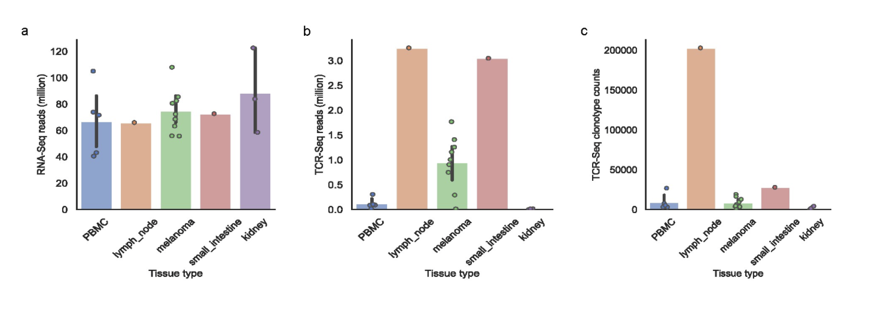
RNAseq reads are consistent across tissue types. Lymph node tissue is the most T cell rich

Slide 8
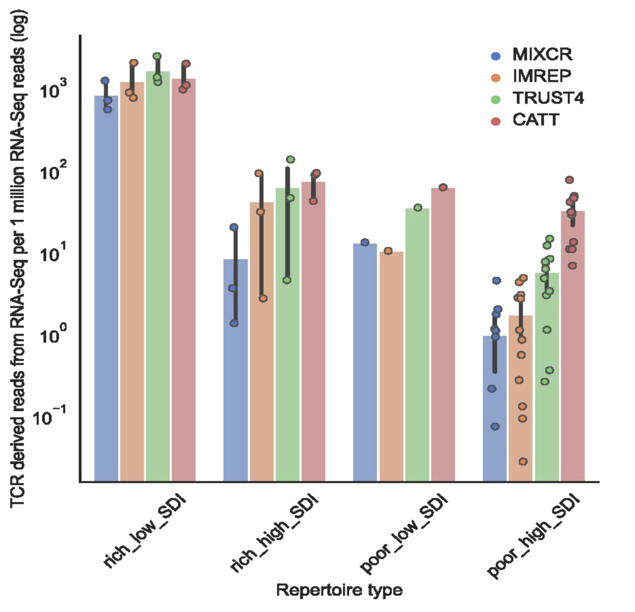
Fewer RNAseq TCR reads in T cell poor tissue vs. T cell rich tissue
Notes:
CATT and TRUST4 perform better than MiXCR in T cell poor high SDI samples

Slide 9
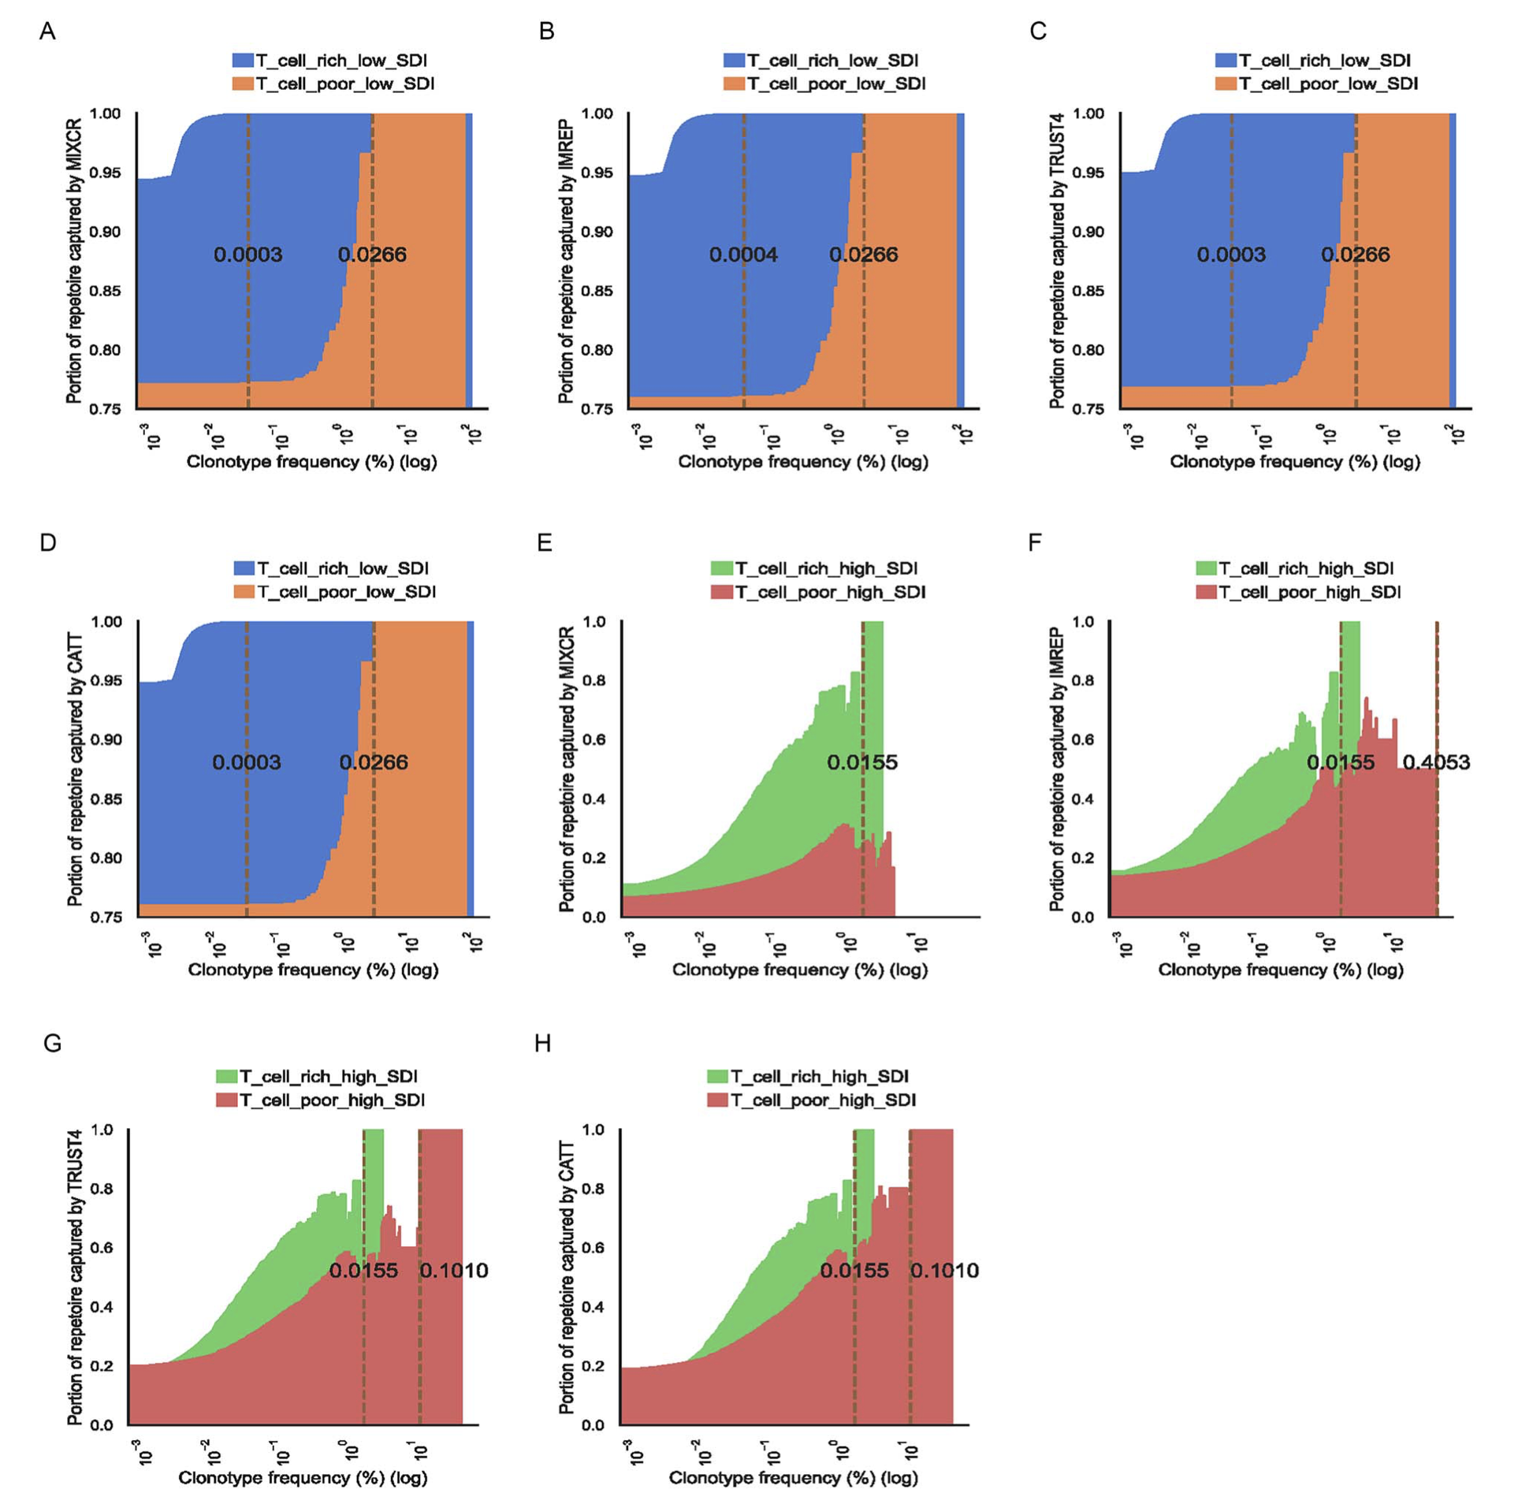
RNAseq methods capture most TCR clonotypes unless sample is T cell poor and high SDI (red)
X-axis: TCRseq confirmed clonotypes with frequency Z
Y-axis: average fraction of TCR clonotypes assembled by RNAseq methods with clonotype frequency > Z
Vertical lines: minimal clonotype frequency above which all clonotypes are captured
Notes:
Area plots show proportion of TCR clonotypes captured by method based on clonotype frequencies
i.e. better RNAseq method for non-poor/high SDI due to ability to capture all clonotypes with rarer frequencies
Capturing ability based on sum of TCRseq confirmed TCR beta clonotypes captured in RNAseq methods
Samples with no clonotype at given freq are excluded
RNAseq methods capture ~93% of clonotypes in T cell rich low SDI samples, ~76% in T cell poor low SDI samples (average capture %s)
on average TCRβ-derived reads from RNA-Seq reads in T-cell-poor tissues were much smaller than those in T-cell-rich tissues

Slide 10
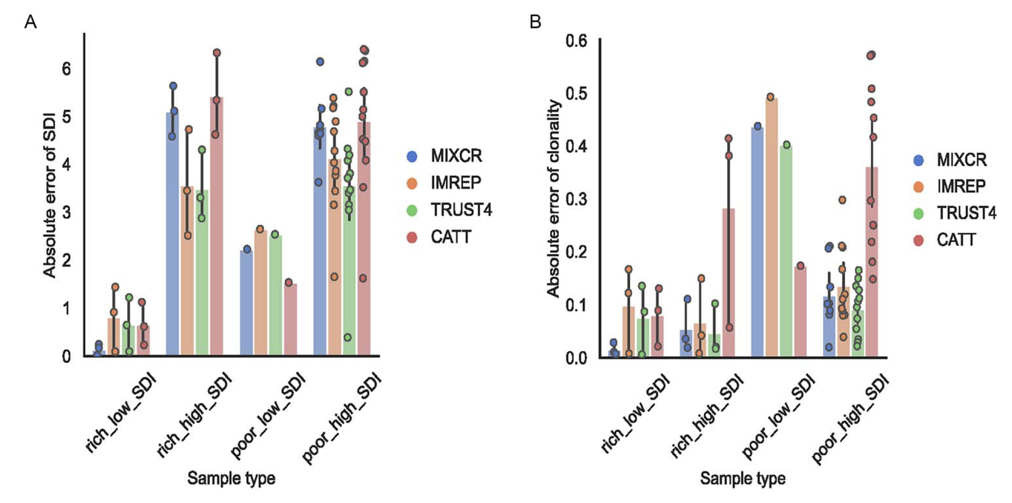
RNAseq methods able to estimate clonality in T cell rich tissues
Y-axis: error between RNAseq & TCRseq based SDI or clonality scores
Notes:
Lower error between RNAseq and TCRseq based diversity estimates in SDI low tissue
Also looked at clonality to take number of clonotypes into account (SDI doesn’t take this into account)
In addition, we investigated the ability of RNA-Seq-based methods to accurately estimate the diversity and clonality when singleton (clonotypes supported by a single read) TCRs were included. The presence of singletons in the sample decreases the accuracy of estimation for all methods. The average absolute error of SDI in T-cell-rich tissues across all methods was slightly higher than the samples excluding singleton TCRs, with values of 2.67 and 2.48, respectively. Similar to the samples excluding singleton TCRs, the surveyed methods provided reliable estimates of diversity in T-cell-rich low SDI samples

Slide 11
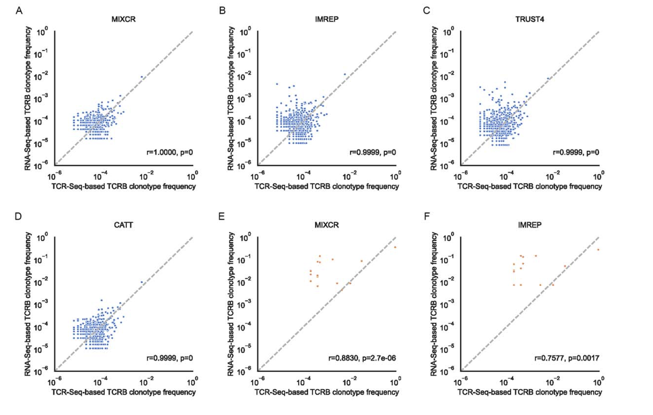
RNAseq estimates clonotype frequencies very well in T cell rich low SDI samples

Slide 12
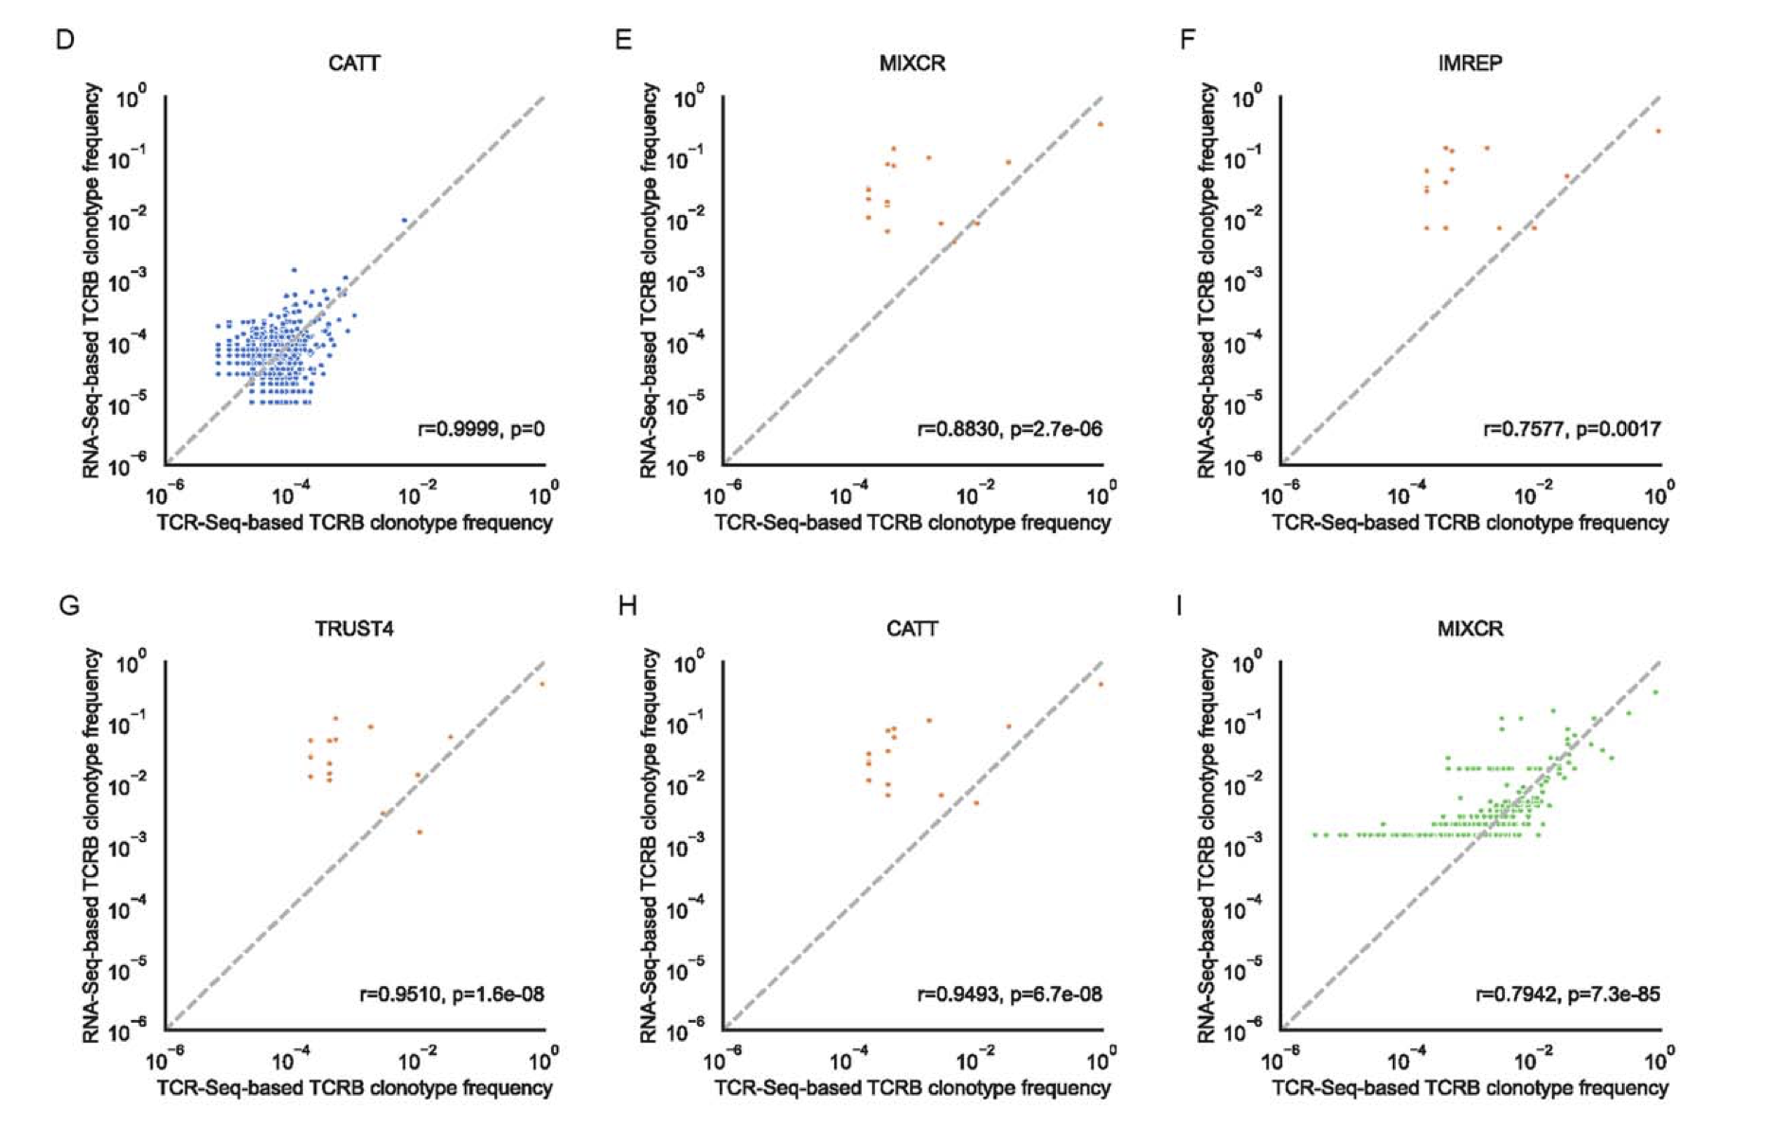
RNAseq estimates clonotype frequencies rather well in T cell poor low SDI samples

Slide 13
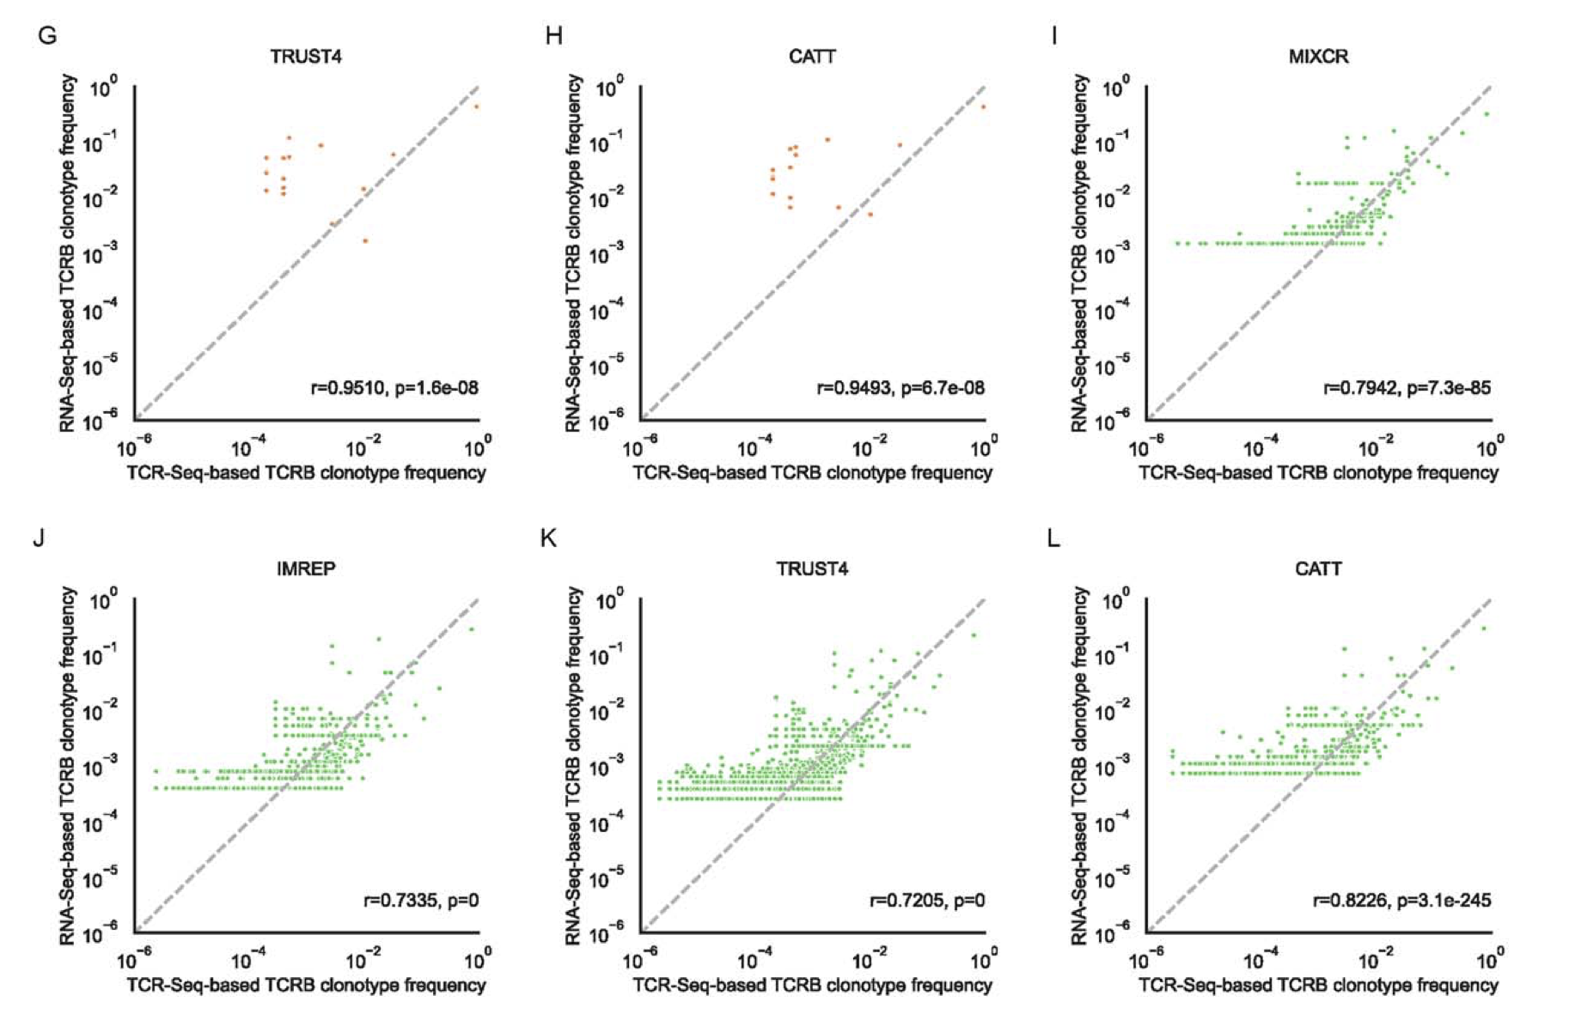
RNAseq estimates clonotype frequencies rather well in T cell high high SDI samples

Slide 14
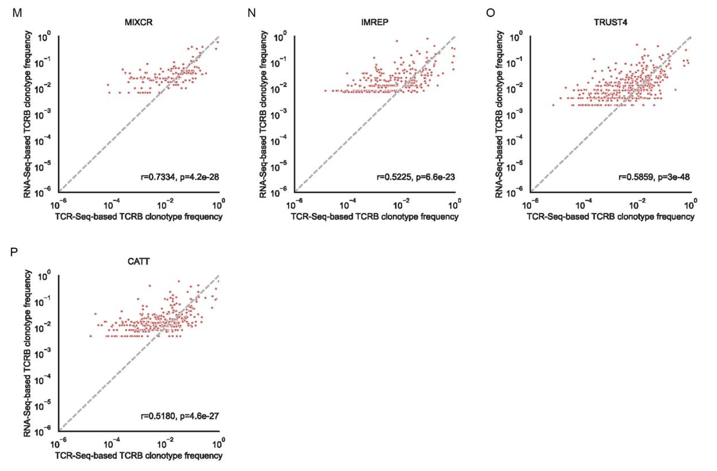
RNAseq estimates clonotype frequencies somewhat well in T cell poor high SDI samples

Slide 15
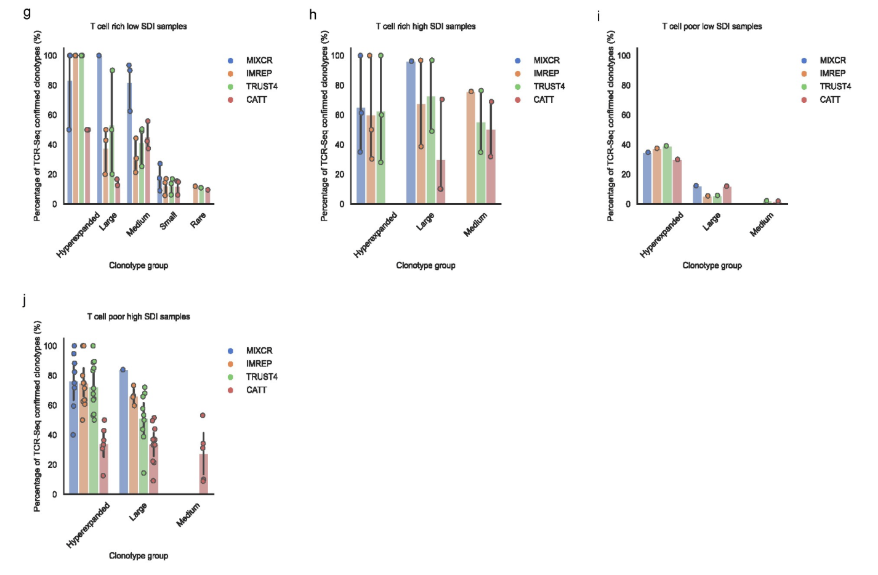
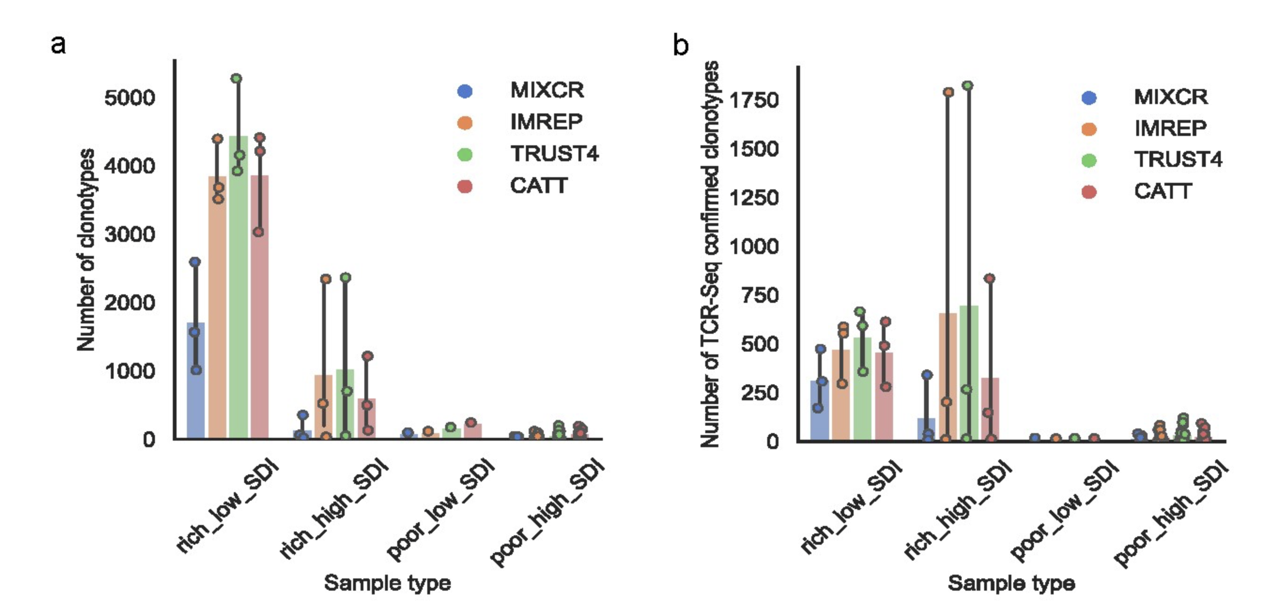
RNAseq methods differ in ability to detect clonotypes
Notes:
ImRep, TRUST4 and CATT were able to detect more clonotypes and TCR-Seq confirmed clonotypes than MiXCR in T-cell-rich tissues. However, CATT had higher portions of the detected hyperexpanded and large clonotypes that were not confirmed by TCR-Seq than all other surveyed methods in T-cell-rich tissues and T-cell-poor high SDI samples.

Slide 16
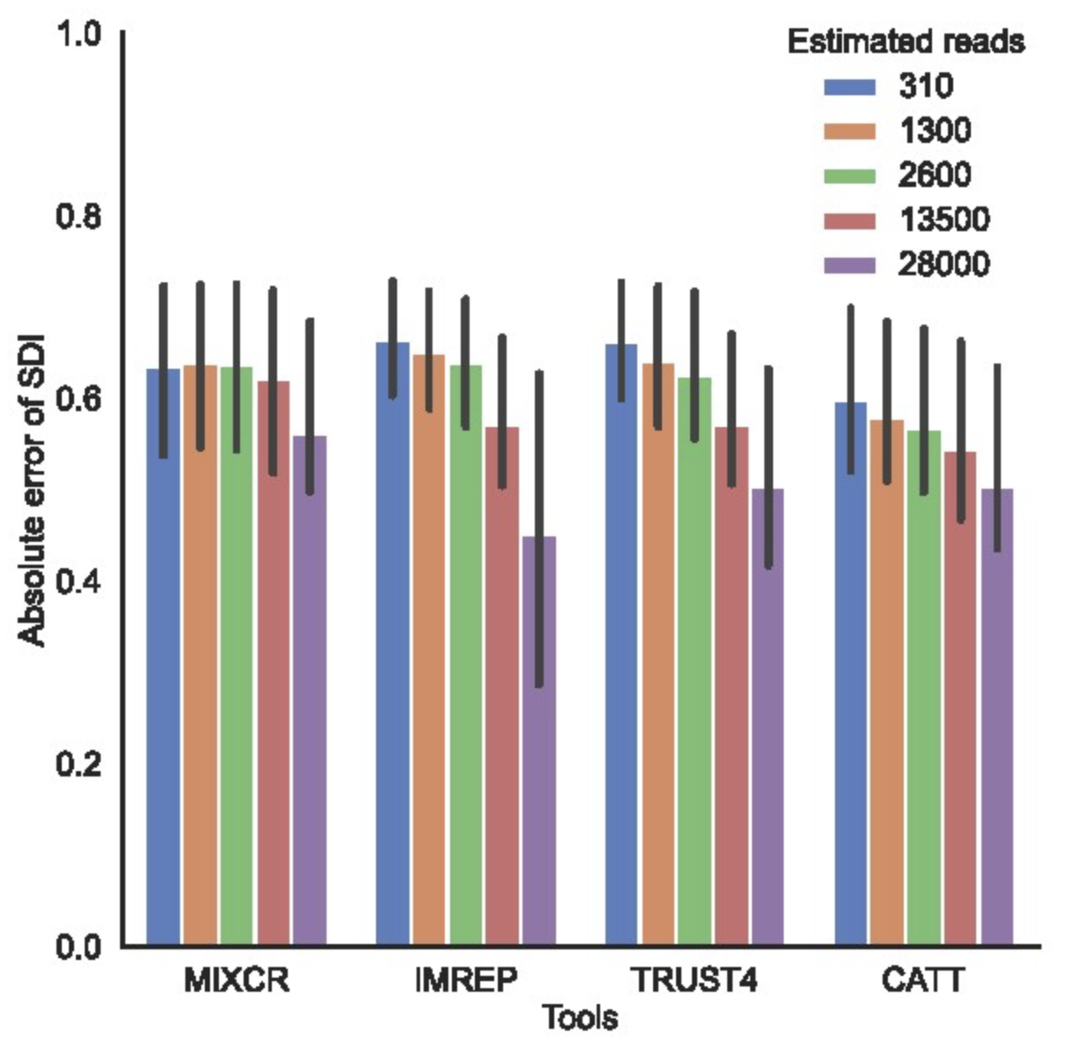
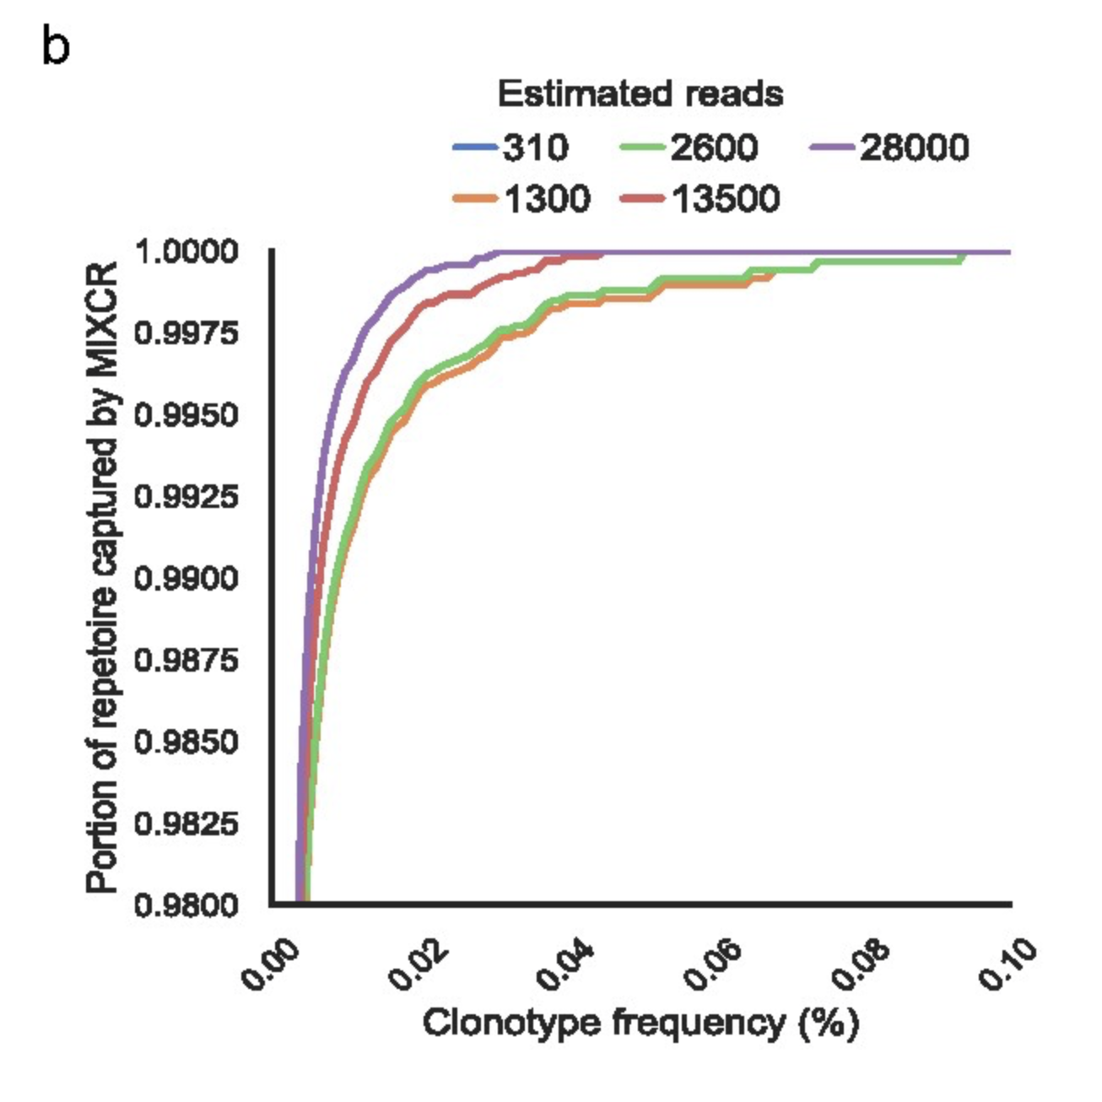
An increased number of TCR-derived reads results in more precise diversity estimate as rarer clonotypes are detected
Notes:
Other method plots looked similar to MiXCR one here (b)

Slide 17
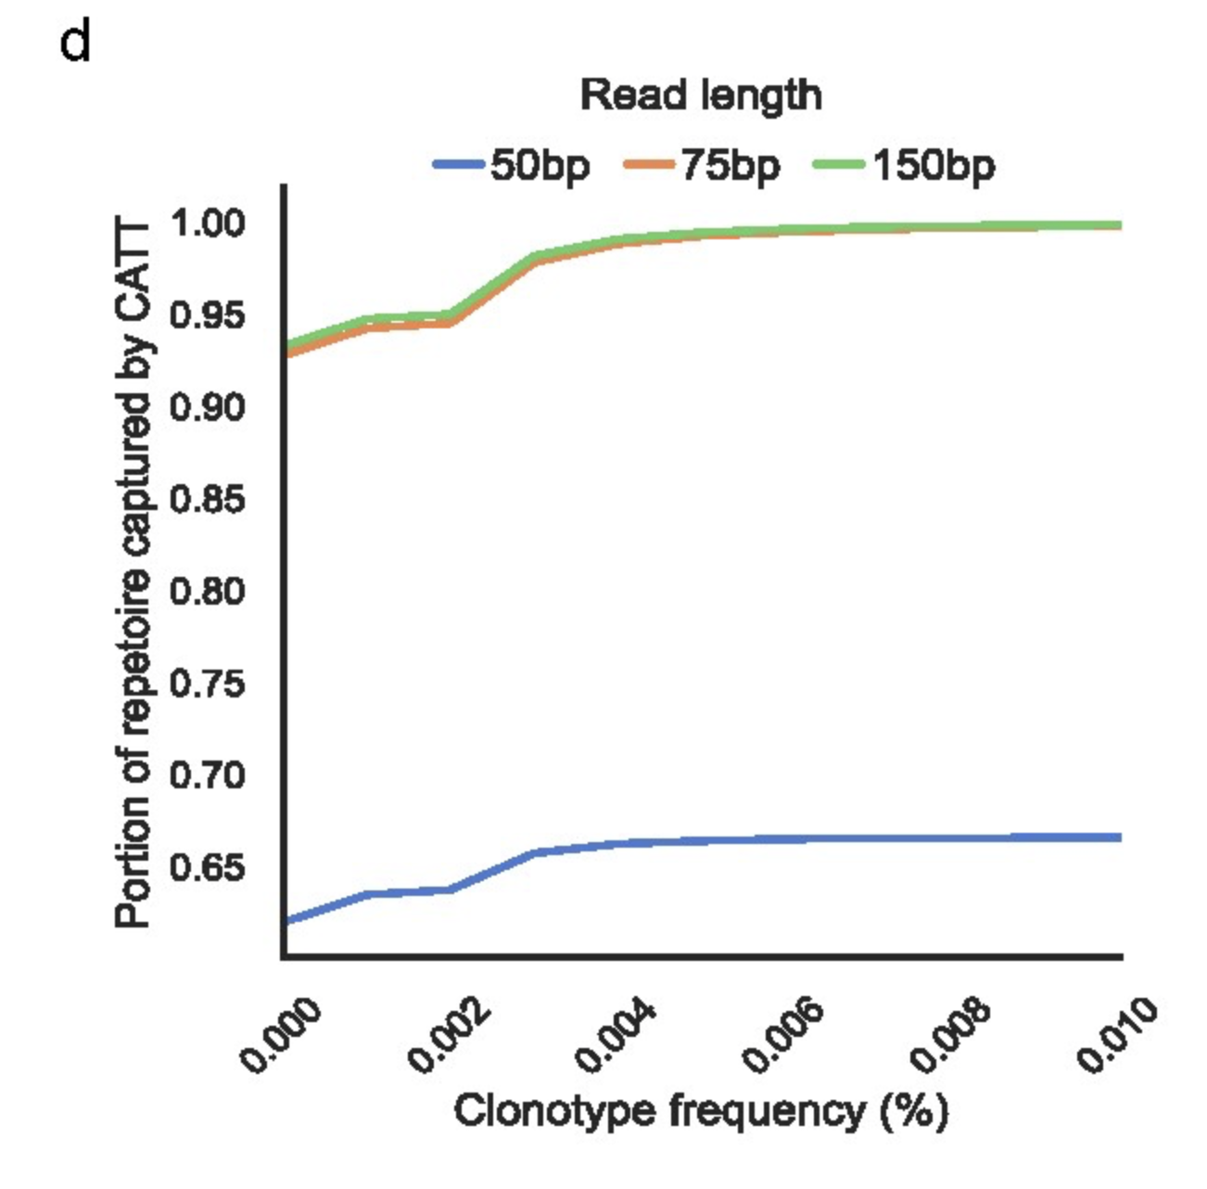
CATT is most sensitive to short read lengths
Notes:
The length of RNA-Seq read was computationally reduced to 50 and 75 bp for PBMC samples

Slide 18
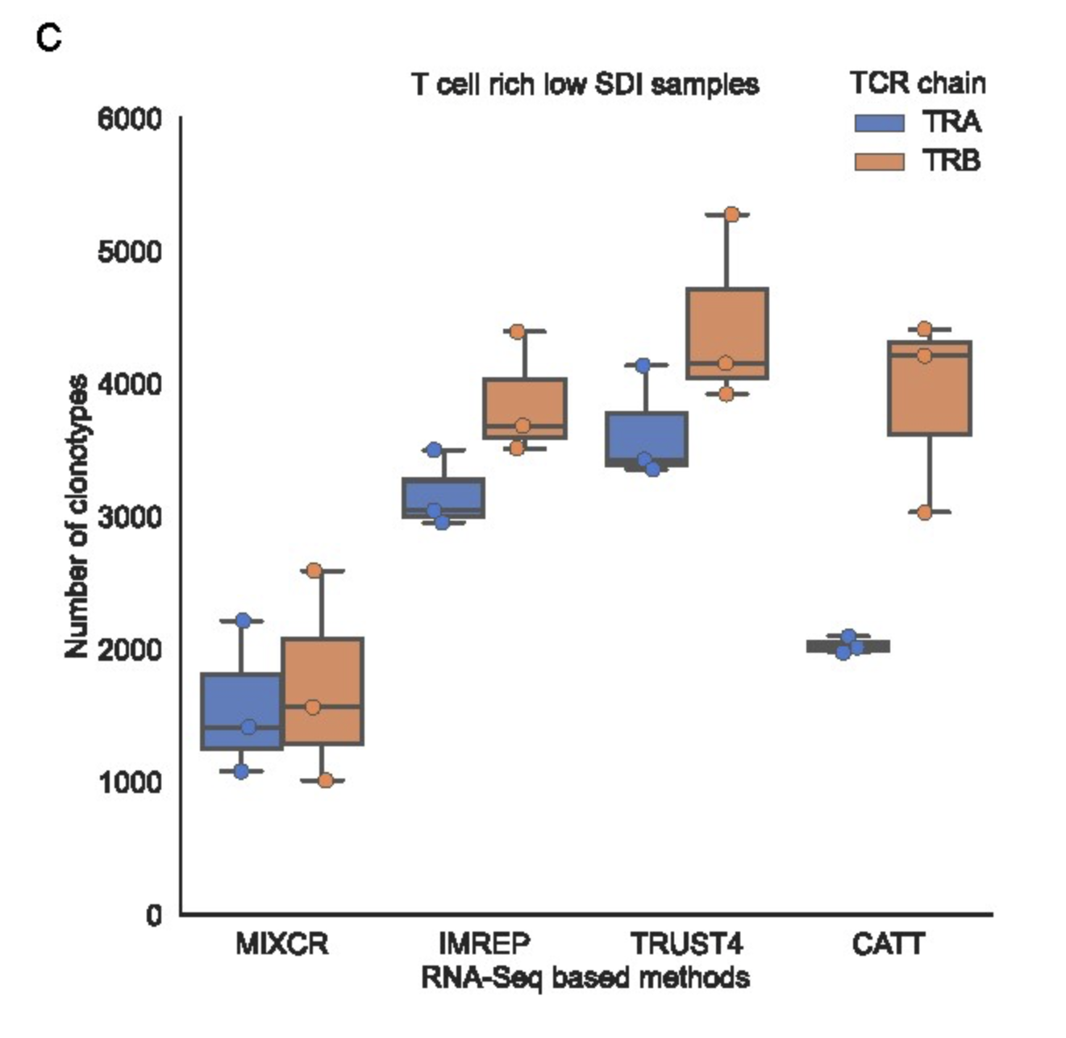
RNAseq methods, most notably CATT, detect fewer TRA clonotypes

Slide 19
Conclusions
RNA-seq approach is suitable to profile TCR repertoire (capture clonotypes, estimate diversity) in T-cell-rich tissues with low diversity repertoires
T-cell-rich tissue: lymph node
Limited power of RNA-seq approach in T-cell-poor tissue, especially those with high T cell diversity
Similar results in healthy patients (data not shown)

Slide 20
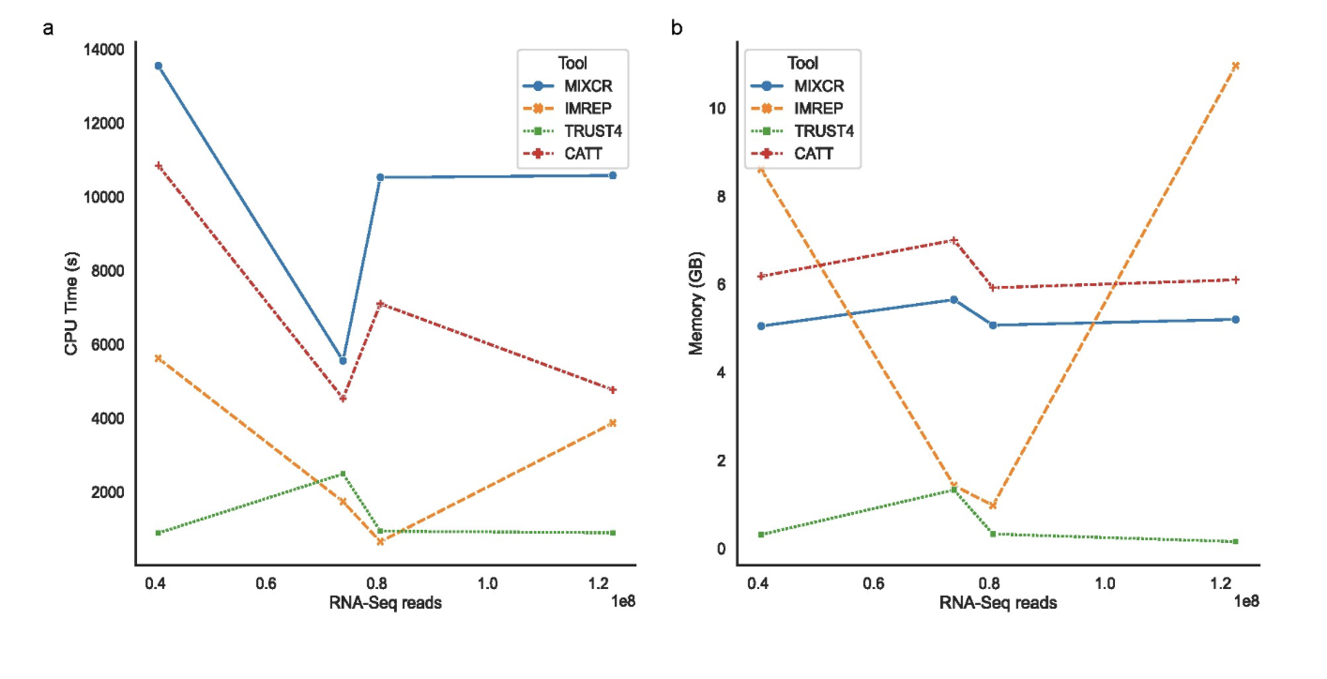
RNAseq methods differ in run time and memory requirements

Slide 21
Applications for us
Not being limited by needing both RNAseq and TCRseq performed, RNAseq can suffice if only interested in top clonotypes
Sometimes paired RNAseq TCRseq datasets have issue of cell having TCR clonotype information but no RNAseq information (& vice a versa)
Saving on costs
Easier to profile α, β, γ and δ chains at same time
Caveats
(cDNA) RNA based clonotype count-based expansion metrics obscured by differences in RNA abundance among clonotypes (gDNA based clonotype counts measures of absolute cell counts)
Assembly may fail at bulk level for some (rare?) clonotypes
False positives from non-immune receptor genes with sequence patterns resembling TCR/CDR3 sequences
Notes:
BRI has used RNAseq methods for TCR at sc not bulk level
TCR-Seq requires separate library preparation and sequencing for α and β chains, while RNA-Seq can capture all four TCR chains (α, β, γ and δ chains) at the same time with single library preparation and sequencing

Slide 22
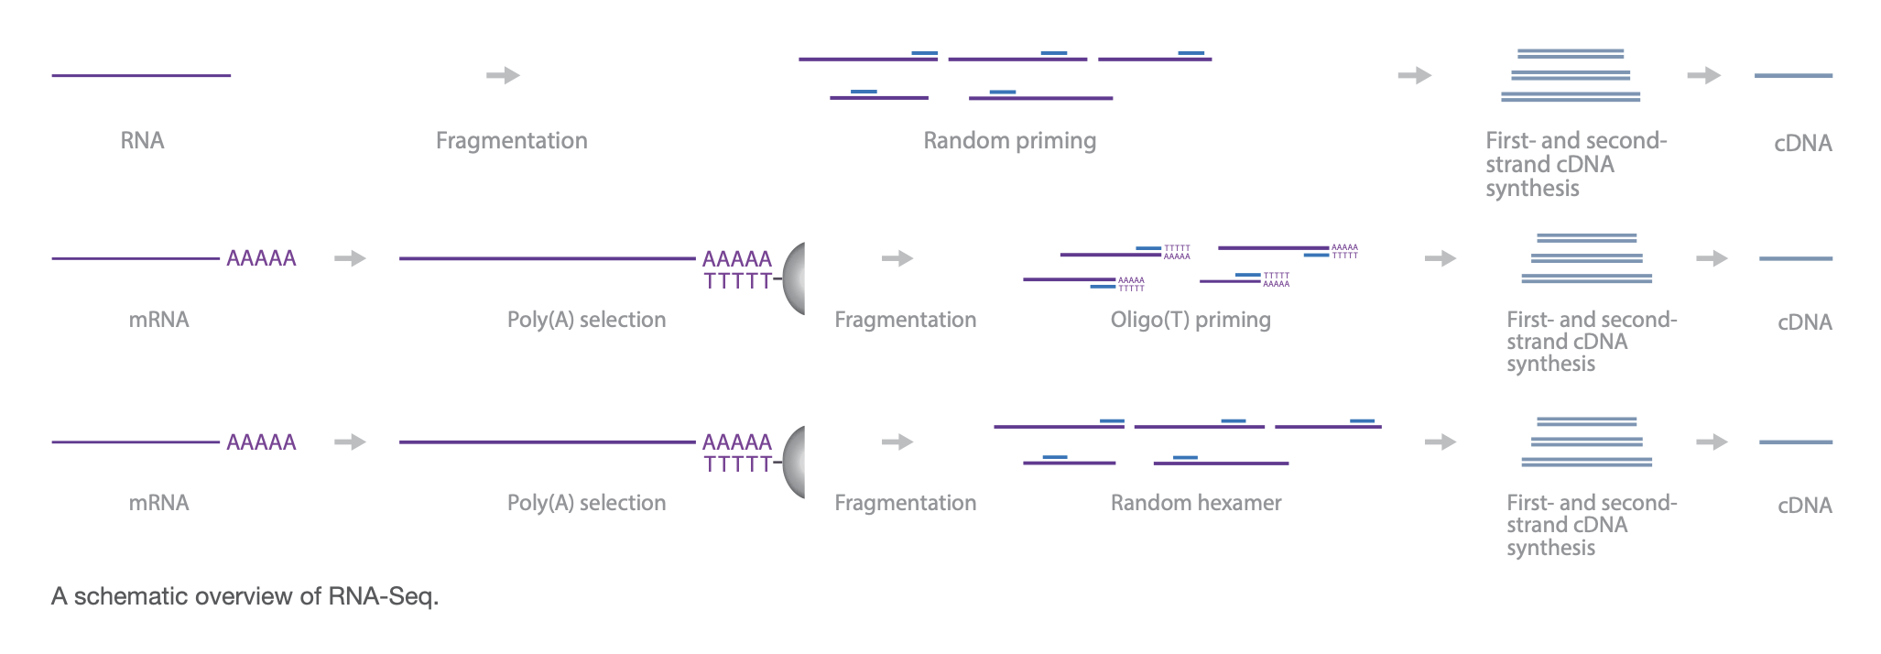
RNAseq methods

Slide 23
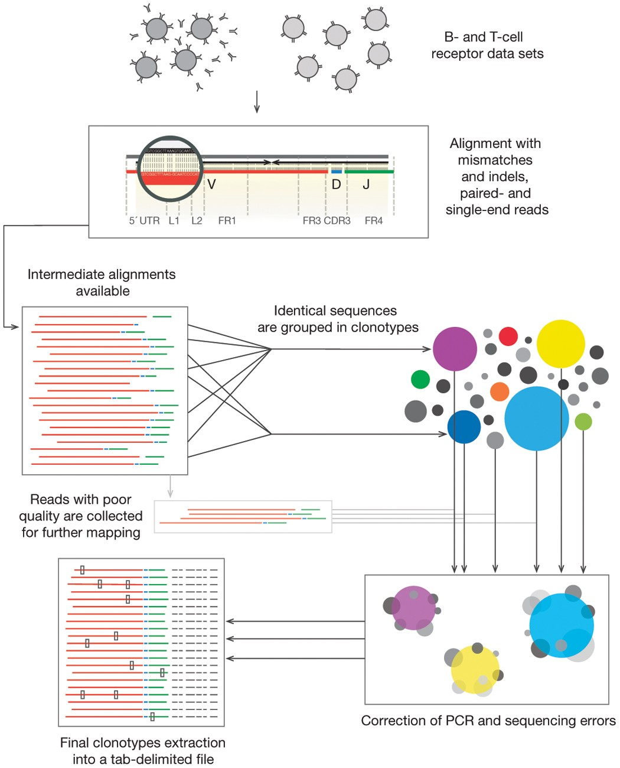
MiXCR main processing steps
align: align sequencing reads to reference V, D, J and C genes of T- or B- cell receptors
assemble: assemble clonotypes using alignments obtained on previous step (in order to extract specific gene regions e.g. CDR3)
export: export alignment (exportAlignments) or clones (exportClones) to human-readable text file

Slide 24
IMREP methods
Infer CDR3 sequences (AAs between C on right of junction and F on left of junction) from reads that overlap V and J gene segments
CAST clustering technique to correct for PCR/sequencing errors
Defines clonotypes as clones with identical CDR3 AA sequences

Slide 25
TRUST4 methods
Uses unselected RNAseq data
De novo assembly on V, J, C genes including hypervariable CDR3
Reports consensus contigs
Realigns contigs to IMGT reference gene sequences to identify gene and CDR3 details
Supports single/paired-end bulk or single-cell sequencing data of any read length
Input: alignment of RNAseq reads in BAM format, along with genomic sequence with VJC gene coordinates, and reference database sequence with annotation information (i.e. IMGT), could also input raw RNAseq files (fasta/fastq)

Slide 26
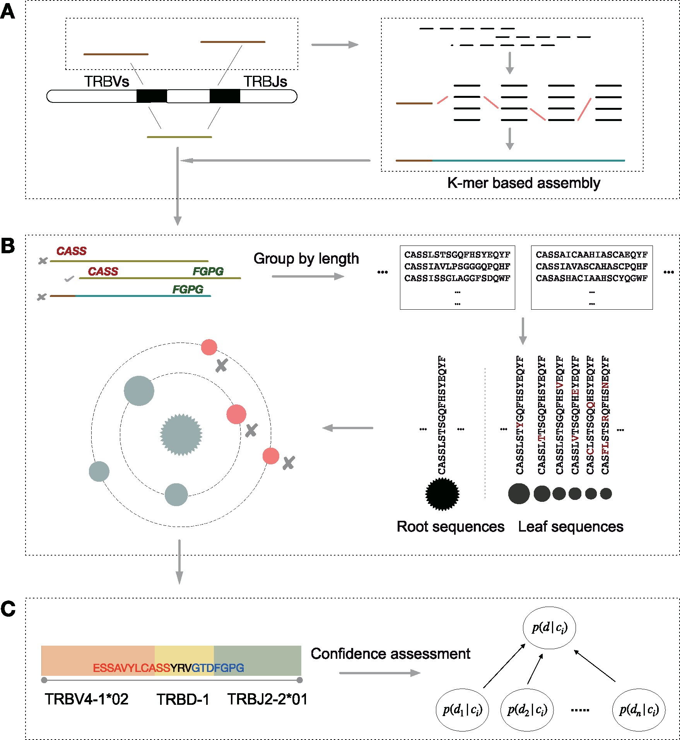
CATT (CharActerizing TCR repertoires) methods
Works for bulk and single cell TCRseq/RNAseq
Data-driven algorithm, self-adaptive to input data
Works even for very short reads
Figure details
A: candidate CDR3 detection. All reads aligned to V/J reference genes to screen candidate reads (brown) for microassembly. CDR3 seqs reconstructed by de Brujin graph-based greedy algorithm
B: error correction. Identify putative CDR3s using IMGT. Eliminate erroneous CDR3s (red)
C: annotation and confidence assessment

Slide 27
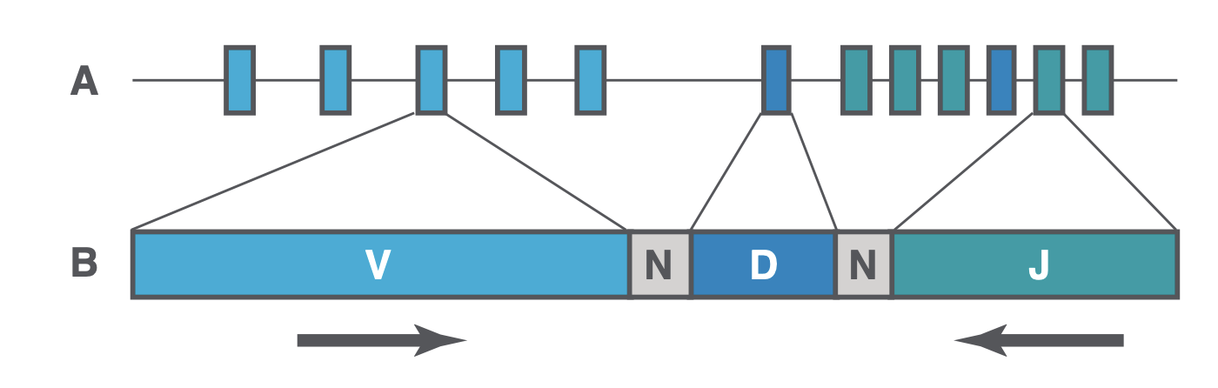
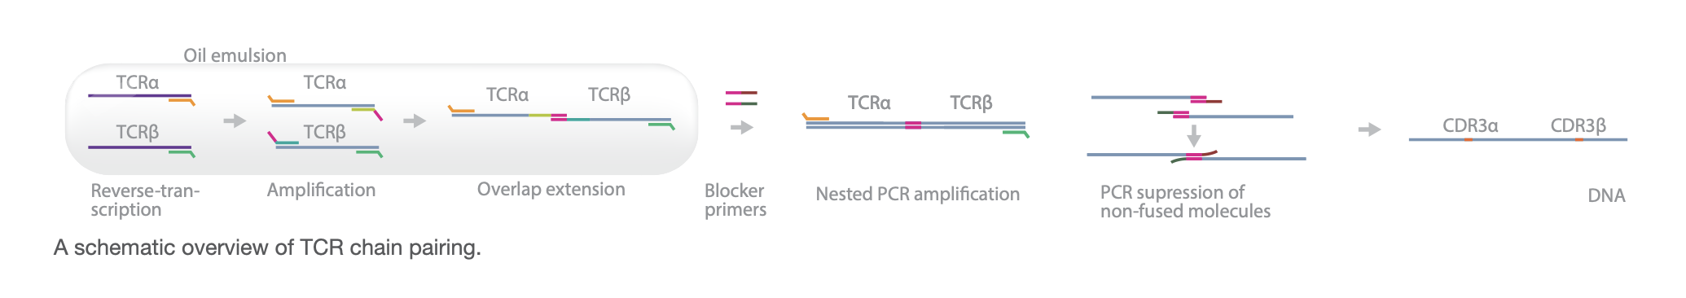
TCRseq methods
Multiplex PCR (pool of primers binds all V and J genes, may be affected by biases), or 5’ RACE (rapid amplification of cDNA ends, single primer set targeting C gene)
DNA (better quantification of clones but more expensive) or RNA based (more sensitive, measures TCR gene expression levels, able to incorporate UMIs to reduce PCR bias)

Slide 28
Publication comments
TRUST and ImRep don’t consider nucleotide quality, MiXCR does (can be disabled)
False positives coming from genomic regions unrelated to immune receptor genes that contain sequence patterns resembling TCR/CDR3 sequences that don’t appear in TCRseq. Instances where TCR clonotypes are identified via RNAseq but not TCRseq could be false positives from RNAseq or false negatives from TCRseq (missed clonotypes). Hard to differentiate between 2 possibilities
Singletons (clones with 1 read) were removed as likely false positives, but perhaps it’s better to just go by Phred quality score to get at errors at nt level

